Slide 1

Assembly Music years 3 and 4

Slide 2
Autumn term

Slide 3
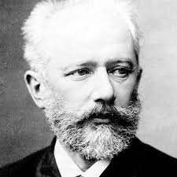
Swan Lake, Dance of the Cygnets by Tchaikovsky
https://youtu.be/Xd2nTXsivHs
He was the first Russian composer whose music would make a lasting impression internationally. He was honored in 1884 by Tsar Alexander III

Slide 4
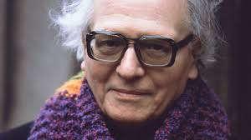
Messiaen was a French composer, organist, and ornithologist from the 20th Century – his keen interest in birds inspired his music!
https://youtu.be/cwDmDTjrBNA
Olivier Messiaen
The Blackbird
December 10, 1908 – April 27, 1992

Slide 5
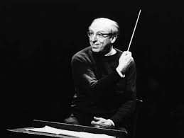
Copland was an American composer whose works are said to capture the open spirit of America.
This is music about real people and their folk tunes and customs; it's full of open plains, a sense of adventure and the American pioneering spirit.
Originally composed in 1942 for a ballet called Rodeo, the Hoe-Down features two American square dance tunes and fuses evocative music and dance.
https://youtu.be/6fUCvxRxK2w
Aaron Copland
Rodeo introduction
November 14, 1900 – December 2, 1990

Slide 6
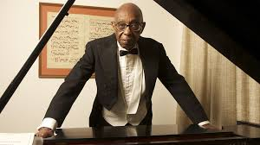
Walker was an American composer, pianist, and organist, who was the first African American to have won the Pulitzer Prize for Music.
https://youtu.be/gZLLVacAT6Y
George Theophilus Walker
Lyrics for Strings
(June 27, 1922 – August 23, 2018)

Slide 7
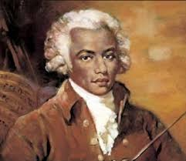
Joseph Bologne was a champion fencer, classical composer, virtuoso violinist, and conductor of the leading symphony orchestra in Paris
He was the first classical composer of African ancestry.
His parents were a wealthy slave owner on a plantation in the West Indies and a slave. So little is known of his musical training, that several myths have grown up around it.
https://youtu.be/VRBUA5rgaLs
Joseph Bologne, Chevalier de Saint-Georges
Symphonie Concertante in G major
(December 25, 1745 – June 12, 1799)

Slide 8
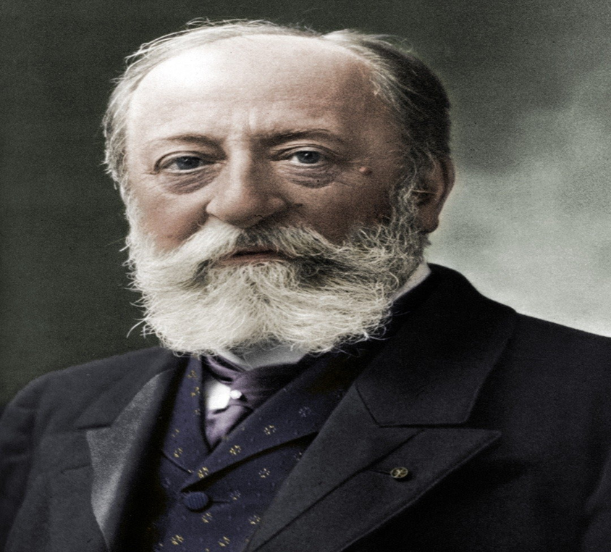
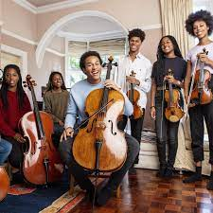
The Swan from Carnival from the Animals by Saint Saens
https://youtu.be/10Z1eNq21yc
Isata Kanneh-Mason, Jeneba Kanneh-Mason, Sheku Kanneh-Mason performing Saint-Saëns: Carnival of the Animals - The Swan.

Slide 9
What makes the Kanneh-Mason siblings so remarkable? Is it the fact that all seven of them seem equally obsessed with music?
They are, by order of age, Isata (25), Braimah (24), Sheku (23), Konya (21), Jeneba (19), Aminata (16) and Mariatu (12), and all play either piano, violin or cello or a combination.
Or is it the fact that their parents Stuart and Kadiatu – neither of them musicians but both musical – didn’t go down the more obvious hot-housing route with specialist music schools but instead opted for state education in Nottingham at a school that truly integrated music into the curriculum?
Or is it the fact that they are equally at home playing Bob Marley, Mozart or medleys from the musicals?

Slide 10
In 2016 cellist Sheku Kanneh-Mason was the first-ever black musician to win the coveted BBC Young Musician, a competition that has been running since 1978.
But he’s not the only one in the family to have made his mark there, with pianist sisters Isata and Jeneba reaching the keyboard finals in 2014 and 2018 respectively.
The family have also performed at the BAFTAs and in 2018 Sheku reached an audience of two billion worldwide when he played at the wedding of Prince Harry and Meghan Markle. Sheku and Isata have both made best-selling recordings and in 2020 all seven released an album built around Saint-Saëns’s Carnival of the Animals with new poems by Michael Morpurgo, of War Horse fame, read by Morpurgo and Olivia Colman, together with irresistible illustrations by Emma Chichester Clark. In May, the family were awarded the Global Award for Best Classical Artist 2021.

Slide 11
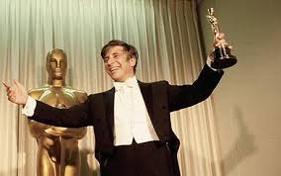
In a career that spanned more than five decades, Elmer Bernstein composed "some of the most recognizable and memorable themes in Hollywood history", including over 150 original movie scores.
https://youtu.be/eeOoh2i7VCw
Elmer Bernstein
The Great Escape
(April 4, 1922 – August 18, 2004)

Slide 12
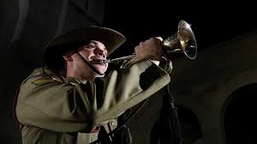
The "First Post" call signals the start of the duty officer's inspection of a British Army camp's sentry posts, sounding a call at each one. The "Last Post" call originally signalled merely that the final sentry post had been inspected, and the camp was secure for the night. In addition, the "Last Post" call had another function at the close of a day of battle. It signalled to those who were still out and wounded or separated that the fighting was done, and to follow the sound of the call to find safety and rest.
The Last Post
https://youtu.be/99tCg596QSc

Slide 13
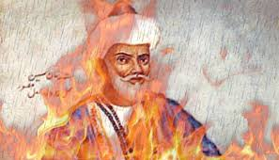
Raag Deepak is one of the six primal ragas of Indian Classical Music. It is believed to be created by Lord Shiva and there is a myth that singing it creates fire.
https://youtu.be/aa26HnAcxYc
Raga Deepak
Ivan Muralow and Ashish Mishra

Slide 14
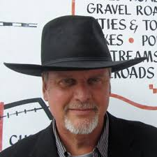
Daugherty is an American composer, pianist, and teacher.
He is influenced by popular culture, Romanticism, and Postmodernism. Daugherty's notable works include his Superman comic book-inspired Metropolis Symphony for Orchestra (1988–93), Dead Elvis for Solo Bassoon and Chamber Ensemble (1993) and many more.
Daugherty has been described by The Times (London) as "a master icon maker" with a "maverick imagination, fearless structural sense and meticulous ear."
https://youtu.be/2PwprdcYa4o
Michael Kevin Daugherty
(born April 28, 1954)

Slide 15
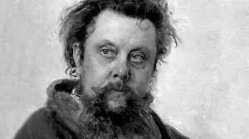
Mussorgsky was a Russian composer, one of the group known as "The Five". He was an innovator of Russian music in the Romantic period. He strove to achieve a uniquely Russian musical identity, often in deliberate defiance of the established conventions of Western music.Many of his works were inspired by Russian history, Russian folklore, and other national themes
https://youtu.be/sxTLk8gWJHg
Modest Petrovich Mussorgsky
The hut on the fowl’s legs and Baba Yaga
21 March 1839 – 28 March 1881

Slide 16
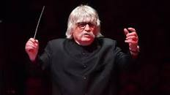
Before Karl Jenkins mainly became involved in composing jazz pieces he was in the rock band Soft Machine.
https://youtu.be/Y2sjLGacUII
Sir Karl William Pamp Jenkins
^{Celebration of Christmas}
born 17 February 1944

Slide 17
Spring term

Slide 18
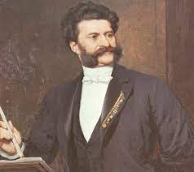
https://youtu.be/tAsdo0zMUyA
Johann Strauss, a composer famous for his Viennese waltzes and operettas.He composed his first waltz at age six.
He was also a violinist.
Highland Cathedral by J Strauss
(1825- 1899)

Slide 19
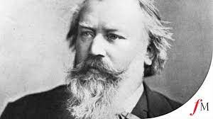
https://youtu.be/6tqOMxaGgBU
Johannes Brahms was a German composer, pianist, and conductor of the Romantic period. Born in Hamburg 1833- 1897.
Brahms: Hungarian Dance no 1

Slide 20
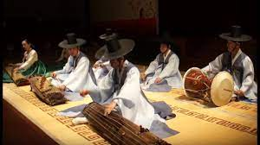
https://youtu.be/IeHBVYDVrrE
Together, traditional Korean music is referred to as gugak (Hangul: 국악), which literally means "national music."
Korean music is the art concerned with combining vocal or instrumental sounds for beauty of form or emotional expression
Traditional Korean Musical performance

Slide 21
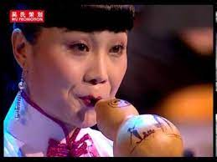
https://youtu.be/2LX7QoL1Dxk
Chinese New Year, known in China as the Spring Festival and in Singapore as the Lunar New Year, is a holiday on and around the new moon on the first day of the year in the traditional Chinese calendar.
Chinese new year Hulusi Concerto by Hou Yanqiu

Slide 22
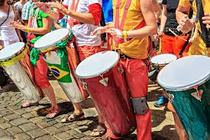
https://youtu.be/jQLvGghaDbE
Samba style developed in the 1950s in the favelas. and includes layering syncopated. rhythms on multiple percussion instruments.
Samba music” Brazil

Slide 23
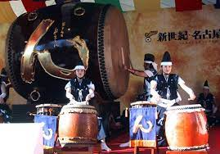
https://youtu.be/jQLvGghaDbE
Taiko Drumming is a blend of music and various martial arts that either originated in Japan or have been imported from China.
The taiko is a large, drum-like instrument of the percussion family that is believed to have originated in Korean and Chinese culture and was introduced to Japan in the 6th century CE. Throughout their history taiko have been used for a variety of purposes including military, theatrical, religious, festival, concert, and communication.
Japanese Drummers Taiko

Slide 24

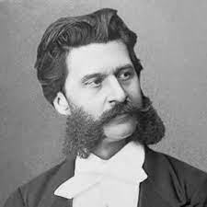
https://youtu.be/IDaJ7rFg66A
The Danube is the second-longest river in Europe
A Viennese waltz is a music and dance which started in Vienna in the late 18th century.
It is a ballroom dance in 3/4 time. It is the most famous of all dance forms.
J Strauss:
The Blue Danube: Violin Solo with orchestra

Slide 25
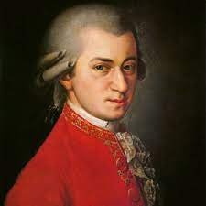
https://youtu.be/fzQbI58BzBo
Mozart was an Austrian composer, instrumentalist, and music teacher.
From a very early age, the young Mozart showed great musical talent.
He toured Europe with his parents and older sister "Nannerl" for several years performing for royalty and the aristocratic elite.
Mozart wrote more than 600 musical works.
Mozart
Turkish March : Piano Solo
January 27, 1756 – December 5, 1791

Slide 26
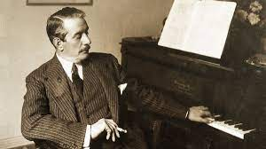
https://youtu.be/cWc7vYjgnTs
Puccini was the most famous Italian opera composer after Verdi.
He wrote 16 operas, most of which are performed very often today.
Many of his operatic songs are known by many people, especially the aria Nessun dorma from Turandot
Puccini
Nessun Dorma from
Opera Turandot: Tenor solo with Orchestra
23 December 1858 - 29 November 1924

Slide 27
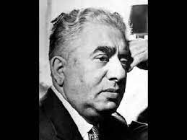
https://youtu.be/mUQHGpxrz-8
Khachaturian was a significant Soviet-American composer.
He studied the cello in the 1920s and went to the Moscow Conservatory in 1929.
He composed several symphonies and a ballet called Gayane.
His music was mainly influenced by the folk music of Armenia.
His most popular piece, the "Sabre Dance" from Gayane, has been used extensively in popular culture and has been covered by a number of musicians worldwide.
Khachaturian
Sabre dance
Born June 1903 and died 1 May 1978 in Moscow

Slide 28
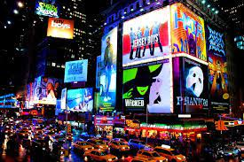
https://youtu.be/R17t65gL-ZU
Broadway was earlier known as the ‘Great White Way’
The Theatre district was one of first streets in New York to be fully illuminated by white electric bulbs in the 1890s, thus giving rise to the nickname “The Great White Way”.
Broadway is the longest street in `new York
Broadway runs for 33 whole miles, of which 18 miles are not even within New York City limits! It begins from Lower Manhattan and runs north to Bronx all the way to Albony.
Broadway Melody: Trumpet solo

Slide 29

https://youtu.be/N00JbKpZKKw
Wolfgang Amadeus Mozart was an Austrian composer, instrumentalist, and music teacher.
He was playing the harpsichord and the violin at the age of five, and writing little pieces of music.
Mozart performed in Munich, Prague, Paris, The Hague and London. In London, he performed for King George III
Variations on a theme of Mozart: trio of oboes
January 27, 1756 – December 5, 1791

Slide 30
Summer term

Slide 31
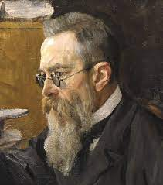
https://youtu.be/QgoC92qtLj4
Scheherazade is a piece of music by Nikolai Rimsky-Korsakov. It was written for orchestra in 1888.
The music was inspired by the Arabian Nights stories.
There are four movements: "Sinbad the Sailor"; "The Kalendar Prince"; "The Young Prince and the Young Princess"; and "Festival at Baghdad". Fokine designed a ballet in 1910 for the Ballets Russes using the music.
Rimsky Korsakov: Sheherazade excerpt ballet with orchestra
18 March 1844, and died in Lybensk, near St Petersburg, 21 June 1908

Slide 32
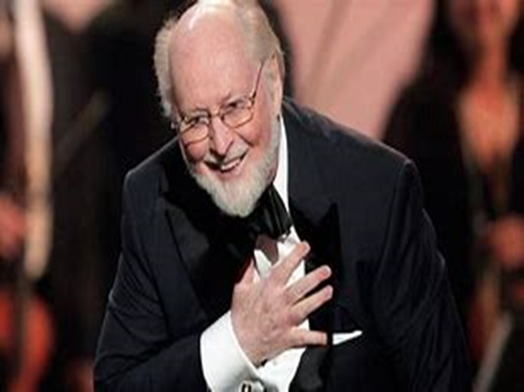
https://youtu.be/30b7_S0paCQ
He is an American composer, conductor, and musician, widely regarded as one of the greatest film composers of all time. In a career that has spanned nearly seven decades he has composed some of the most popular, recognizable, and critically acclaimed film scores in cinematic history.
Williams has won 25 Grammy Awards, seven British Academy Film Awards, five Academy Awards, and four Golden Globe Awards.
In 2005, the American Film Institute selected Williams's score to my Award nominations, he is the second 1977's Star Wars as the greatest film score of all time.
Williams has composed for many critically acclaimed and popular movies, including the Star Wars saga, Jaws, Close Encounters of the Third Kind, Superman, E.T. the Extra-Terrestrial, Home Alone, the Indiana Jones films, the first two Jurassic Park films, Schindler's List, and the first three Harry Potter films.
Harry Potter and the Sorcerer’s Stone-Suite
John Williams
born February 8, 1932

Slide 33
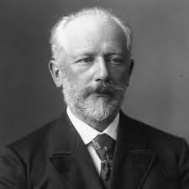
https://youtu.be/g6eA4PjWhws
Tchaikowsky was a Russian composer who lived in the Romantic period. The Sleeping Beauty is a ballet in a prologue and three acts. Marius Petipa and Ivan Vsevolojsky wrote the story of the ballet. It was based on Charles Perrault's 1697 fairy tale "The Sleeping Beauty in the Wood". Tchaikovsky wrote the music.
The Sleeping Beauty was first presented at the Mariinsky Theatre in St. Petersburg, Russia, on 15 January 1890
Sleeping Beauty by Tchaikowsky
born Kamsko-Votkinsk, 7 May 1840; died St Petersburg, 6 November 1893

Slide 34
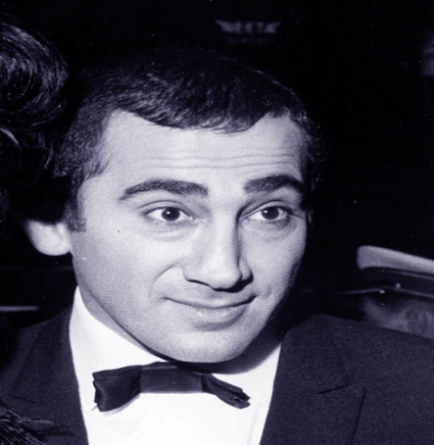
https://youtu.be/5ZsoephKGZs
Oliver! is a British musical, with music and lyrics by Lionel Bart. The musical is based upon the 1838 novel Oliver Twist by Charles Dickens.
Lionel Bartwas a British writer and composer of pop music and musicals. He wrote Tommy Steele's "Rock with the Caveman" and was the sole creator of the musical Oliver! (1960).
Who will buy
Composer: Lionel Bart
(1 August 1930 – 3 April 1999)

Slide 35
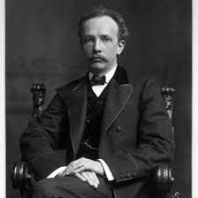
https://youtu.be/dfe8tCcHnKY
https://youtu.be/M-2ed2hY6Ck
Strauss was a German composer. He soon became very famous when he was a young man.
His tone-poems were played by orchestras all over Europe.
Strauss was the last great composer who wrote in a Romantic style.
Sprach Zarathustra by
Richard Strauss
born Munich 1864; died Bavaria1949

Slide 36
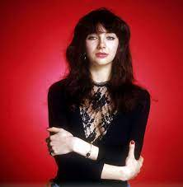
https://youtu.be/Fk-4lXLM34g
"Wuthering Heights" is a song by British singer-songwriter Kate Bush, released as her debut single on 20 January 1978. Inspired by the 1847 Emily Brontë novel of the same name, it appears on her 1978 debut album The Kick Inside. It stayed at number one on the UK Singles Chart for four weeks, and remains Bush's most successful single. The song received widespread critical acclaim and continues to be highly regarded;
Wuthering Heights by kate Bush

Slide 37
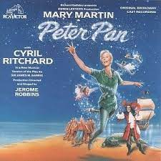
https://youtu.be/bFkyhlIm4m0
The Second Star to the Right" is the opening song to the 1953 film Peter Pan. It is sung by an offscreen chorus and refers to the entrance to Neverland. It is then heard instrumentally after the opening credits where an offscreen narrator introduces the viewers to the Darling family's house, the house Peter Pan chose particularly because there were people who believed in him.
Peter pan: Second star to the right

Slide 38
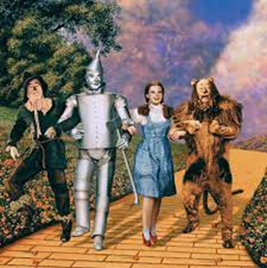
https://youtu.be/stCIkeMGTTc
Wizard of Oz Royal variety performance

Slide 39
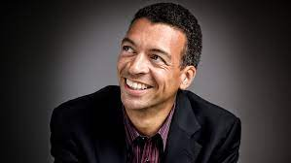
§https://youtu.be/BMAZe89O61k
Paul Robeson sang “Ol' Man River” in the movie “Show Boat,” a romantic musical film released in 1936.
The movie is based on a novel by Edna Ferber and a Broadway musical, directed by Jerome Kern and Oscar Hammerstein II.
The musical follows the lives of the performers, stagehands and dock workers on the Cotton Blossom, a Mississippi River show boat, over 40 years from 1887 to 1927
Old Man River from Showboat by Williams

Slide 40
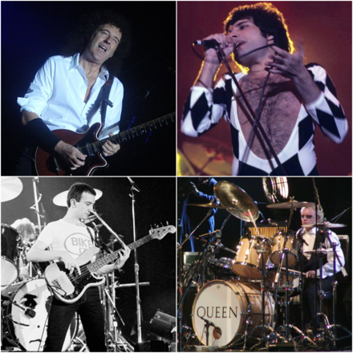
https://youtu.be/FP808MiJUcM
Queen are a British rock band formed in London in 1970. Their classic line-up was Freddie Mercury (lead vocals, piano),
Brian May (guitar, vocals),
Roger Taylor (drums, vocals)
and John Deacon (bass).
Their earliest works were influenced by progressive rock, hard rock and heavy metal, but the band gradually ventured into more conventional and radio-friendly works by incorporating further styles, such as arena rock and pop rock. "We Are the Champions" is a song by the British rock band Queen, first released on their 1977 album News of the World.
Written by lead singer Freddie Mercury, it remains among rock's most recognisable anthems.
The song was a worldwide success, reaching number two in the UK Singles Chart
Queen
We are the Champions

Slide 41
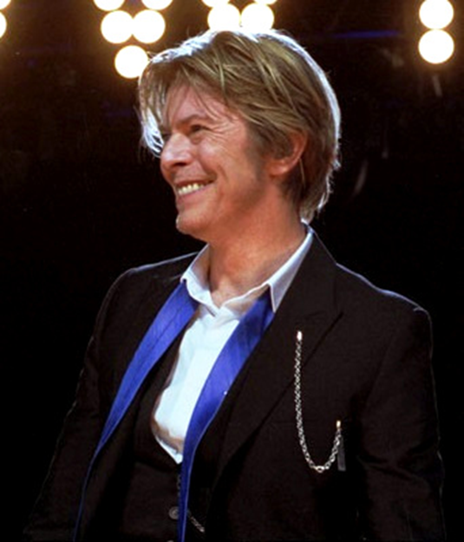
https://youtu.be/AZKcl4-tcu
"Life on Mars" is a song by English singer-songwriter David Bowie, first released on his 1971 album Hunky Dory.
David Bowie
Life on Mars
1947 – 10 January 2016

Slide 42
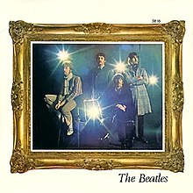
https://youtu.be/S-rB0pHI9fU
"Penny Lane" is a song by the English rock band the Beatles that was released in February 1967 as a double A-side single with "Strawberry Fields Forever".
It was written primarily by Paul McCartney and credited to the Lennon–McCartney songwriting partnership.
The lyrics refer to Penny Lane, a street in Liverpool, and make mention of the sights and characters that McCartney recalled from his upbringing in the city.
The Beatles
PennyLane
1960-1970 as a band

